Slide 1
Principles of Data Science
Li Niu

Slide 2
Domain Adaptation
Unsupervised domain adaptation
Supervised domain adaptation
Semi-supervised domain adaptation

Slide 3
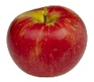
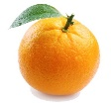

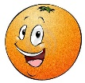
Domain Adaptation
Unsupervised domain adaptation
apple
orange
?
?
source domain
target domain
training stage

Slide 4
Domain Adaptation
Supervised domain adaptation
apple
orange
apple
orange
source domain
target domain
training stage

Slide 5
Domain Adaptation
Semi-supervised domain adaptation
apple
orange
apple
?
source domain
target domain
training stage

Slide 6
Domain Adaptation
Traditional era
Early deep era
GAN era

Slide 7
Domain Adaptation
Traditional era
Projection to common subspace
Interpolation on the manifold
Sample selection
Domain-invariant dictionary
Low-rank reconstruction

Slide 8
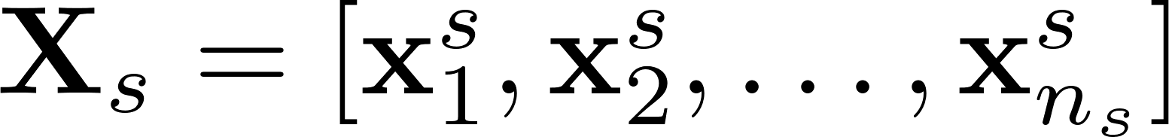
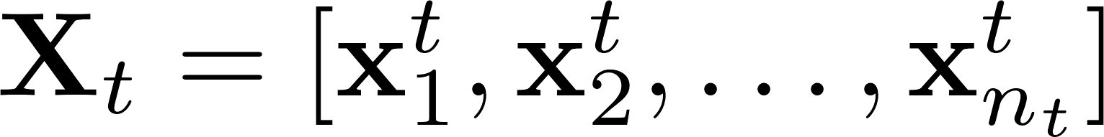
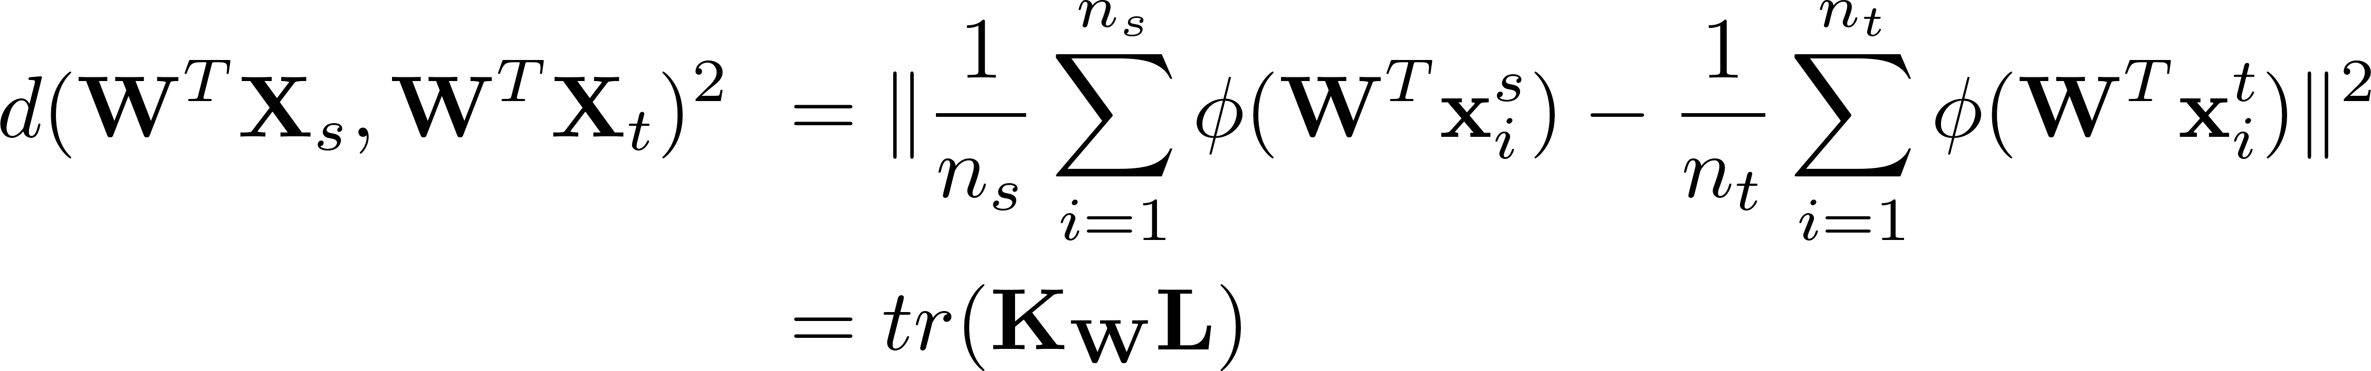
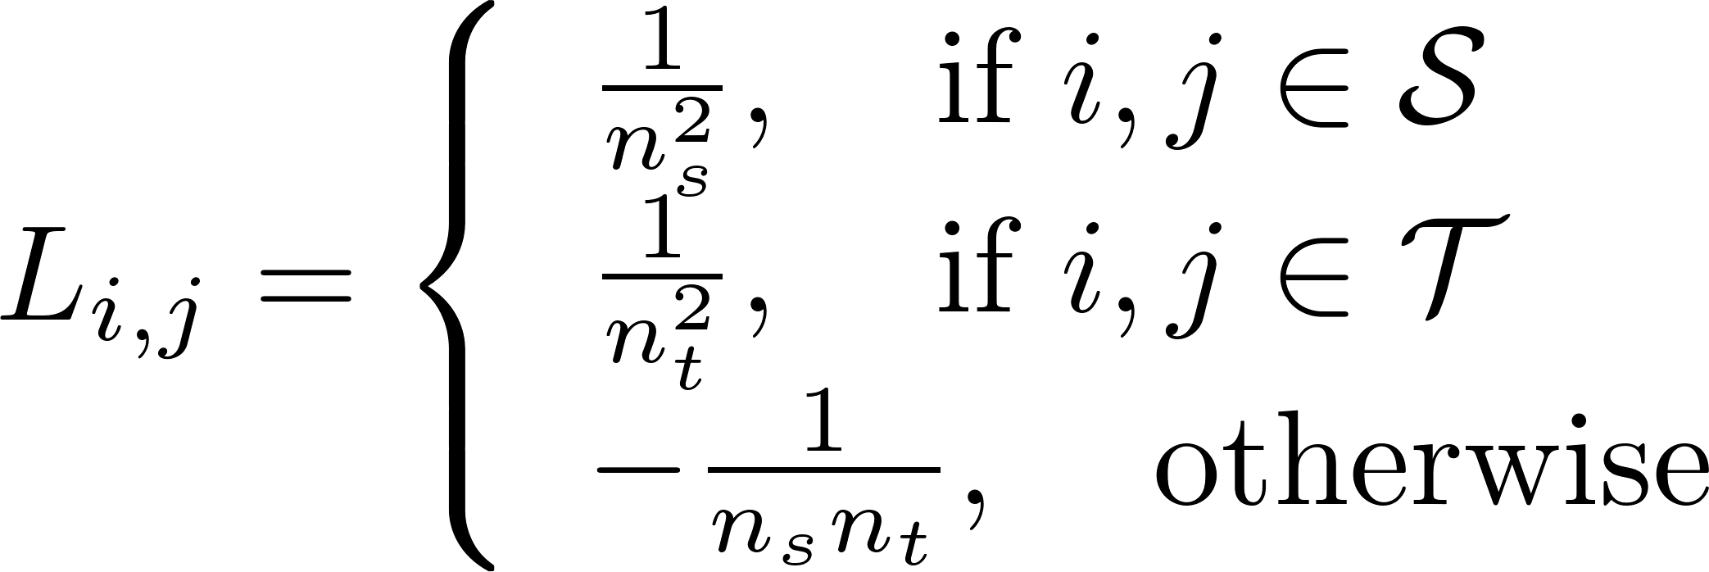
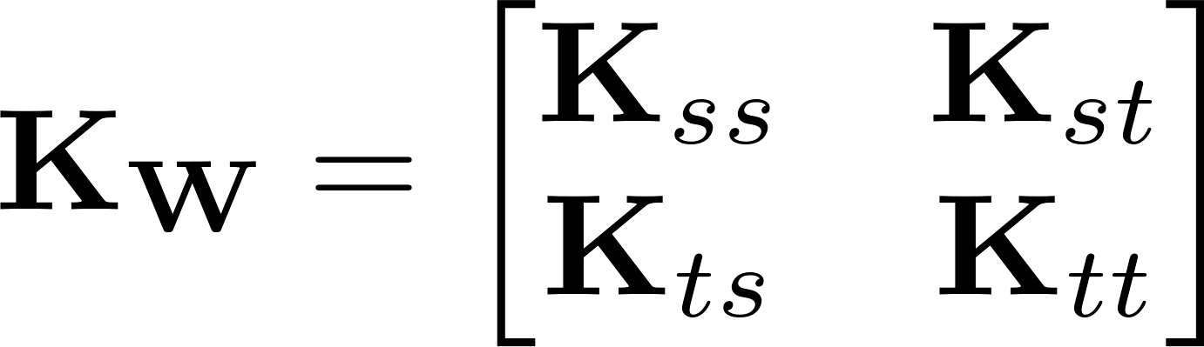
Domain Invariant Projection (DIP)
Baktashmotlagh, Mahsa, et al. "Unsupervised domain adaptation by domain invariant projection." ICCV, 2013.
source
target

Slide 9
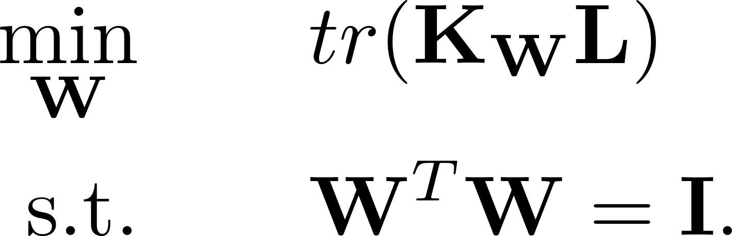
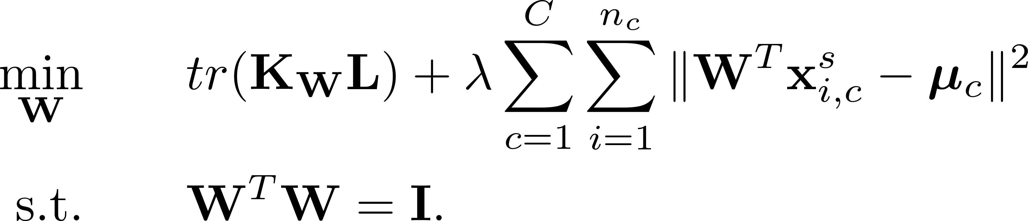

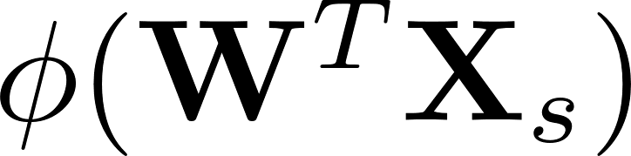
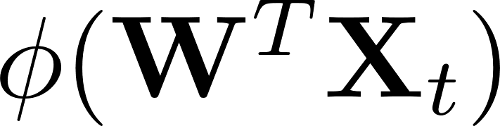
Domain Invariant Projection (DIP)
DIP
Class Clustering
DIP-CC
After obtaining , use and

Slide 10
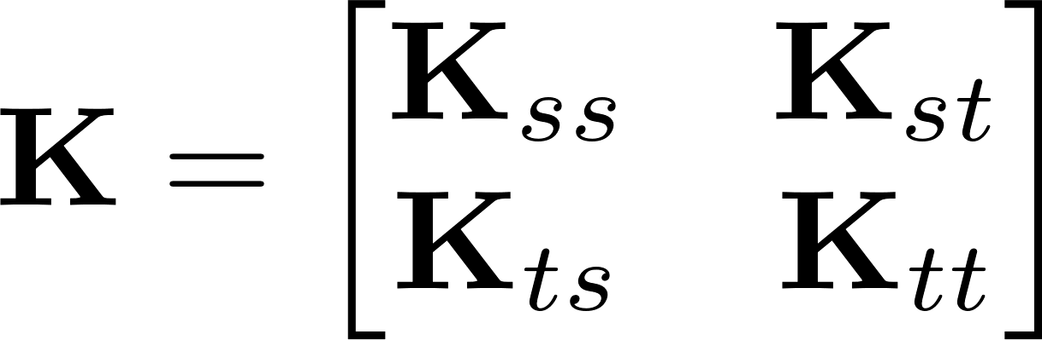
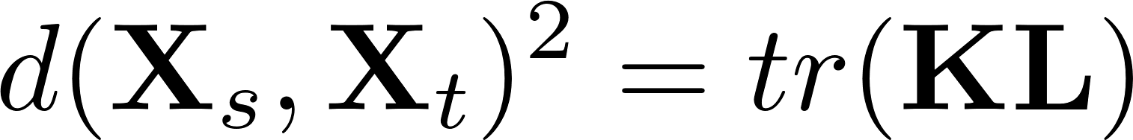

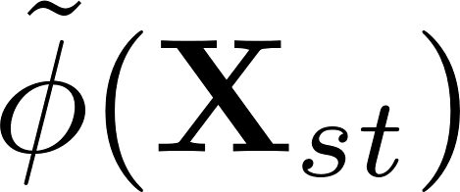

Transfer Component Analysis (TCA)
Pan, Sinno Jialin, et al. "Domain adaptation via transfer component analysis.“ TNN (2011): 199-210.
, in which
Introduce transformation matrix for fake representation
, in which

Slide 11
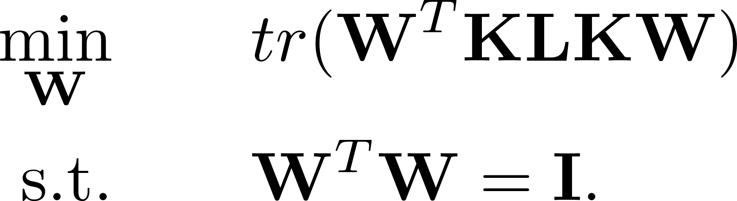
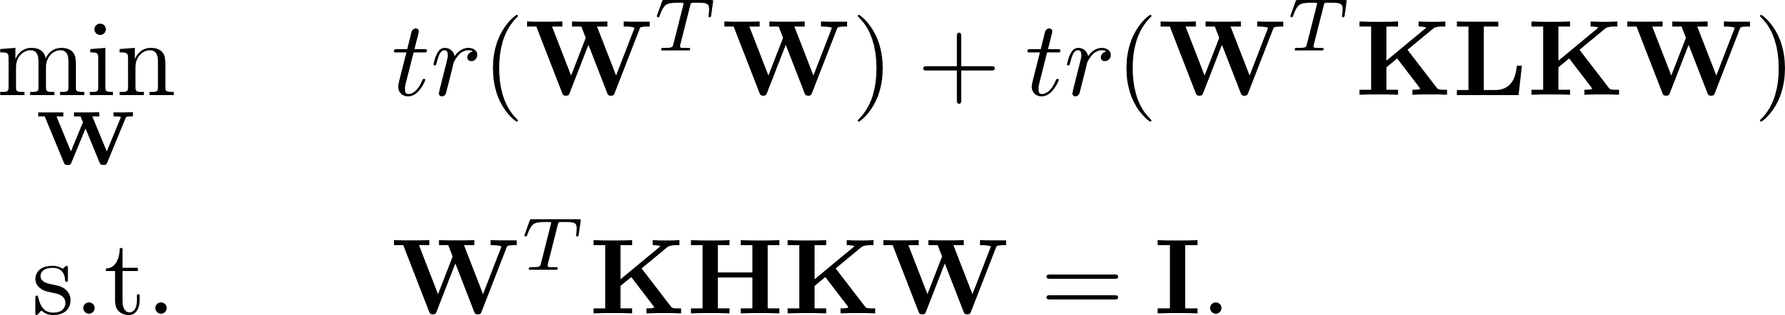
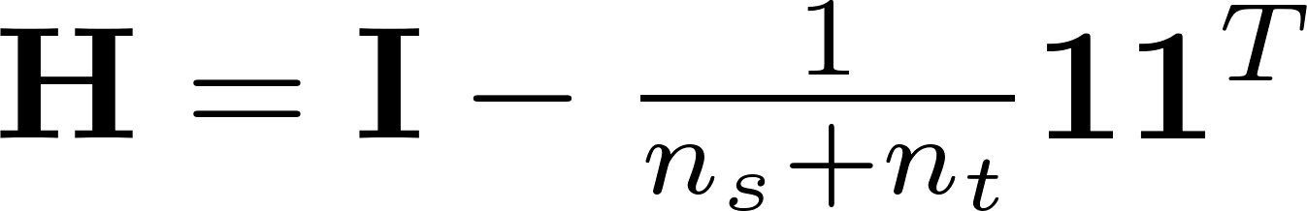

Transfer Component Analysis (TCA)
TCA
normalization constraint
After obtaining , use the new kernel

Slide 12
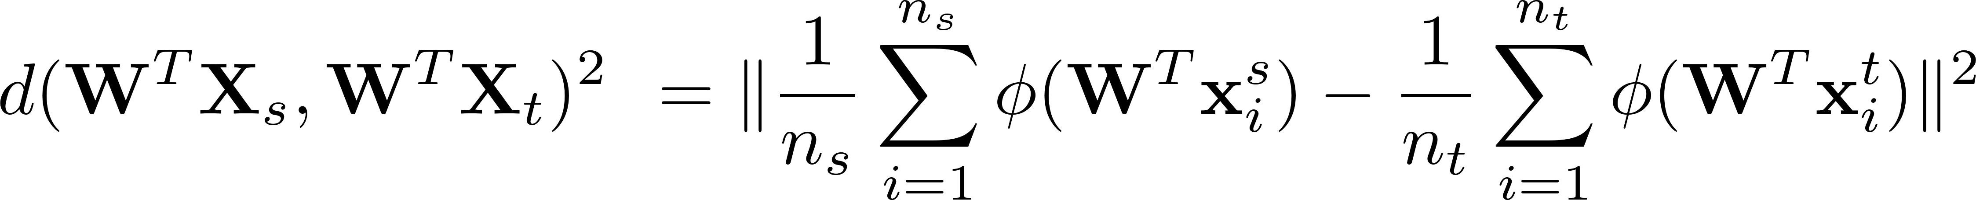
Relation Between DIP and TCA
DIP: apply projection before kernelization
TCA: apply projection after kernelization

Slide 13
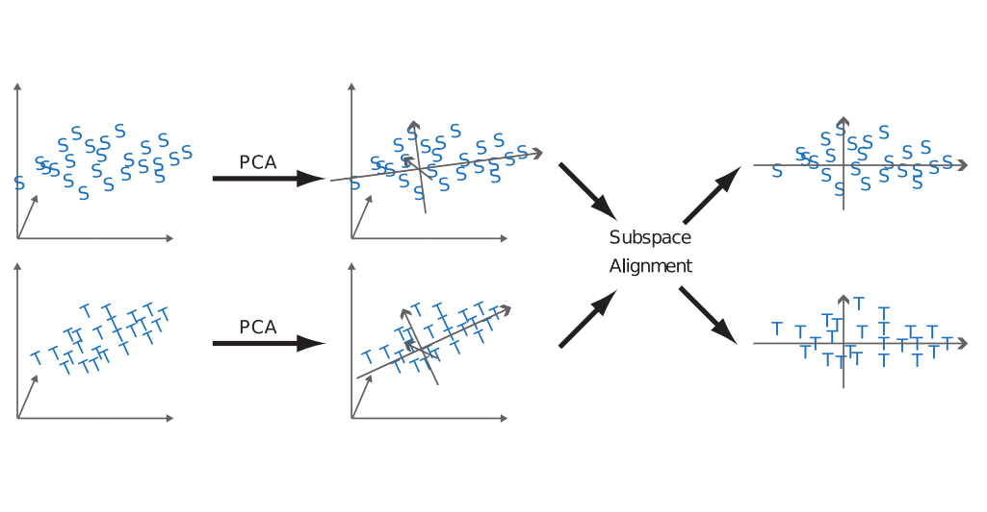
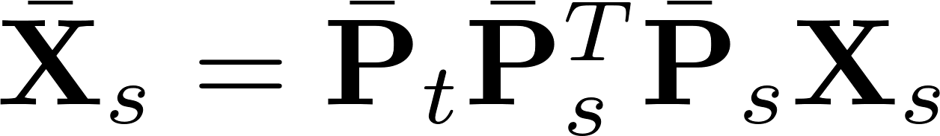
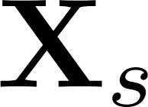
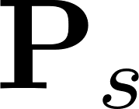
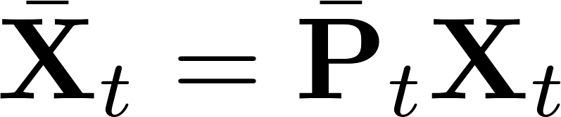
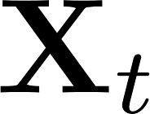
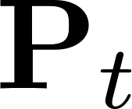
Subspace Alignment (SA)
Fernando, Basura, et al. "Unsupervised visual domain adaptation using subspace alignment." ICCV, 2013.

Slide 14
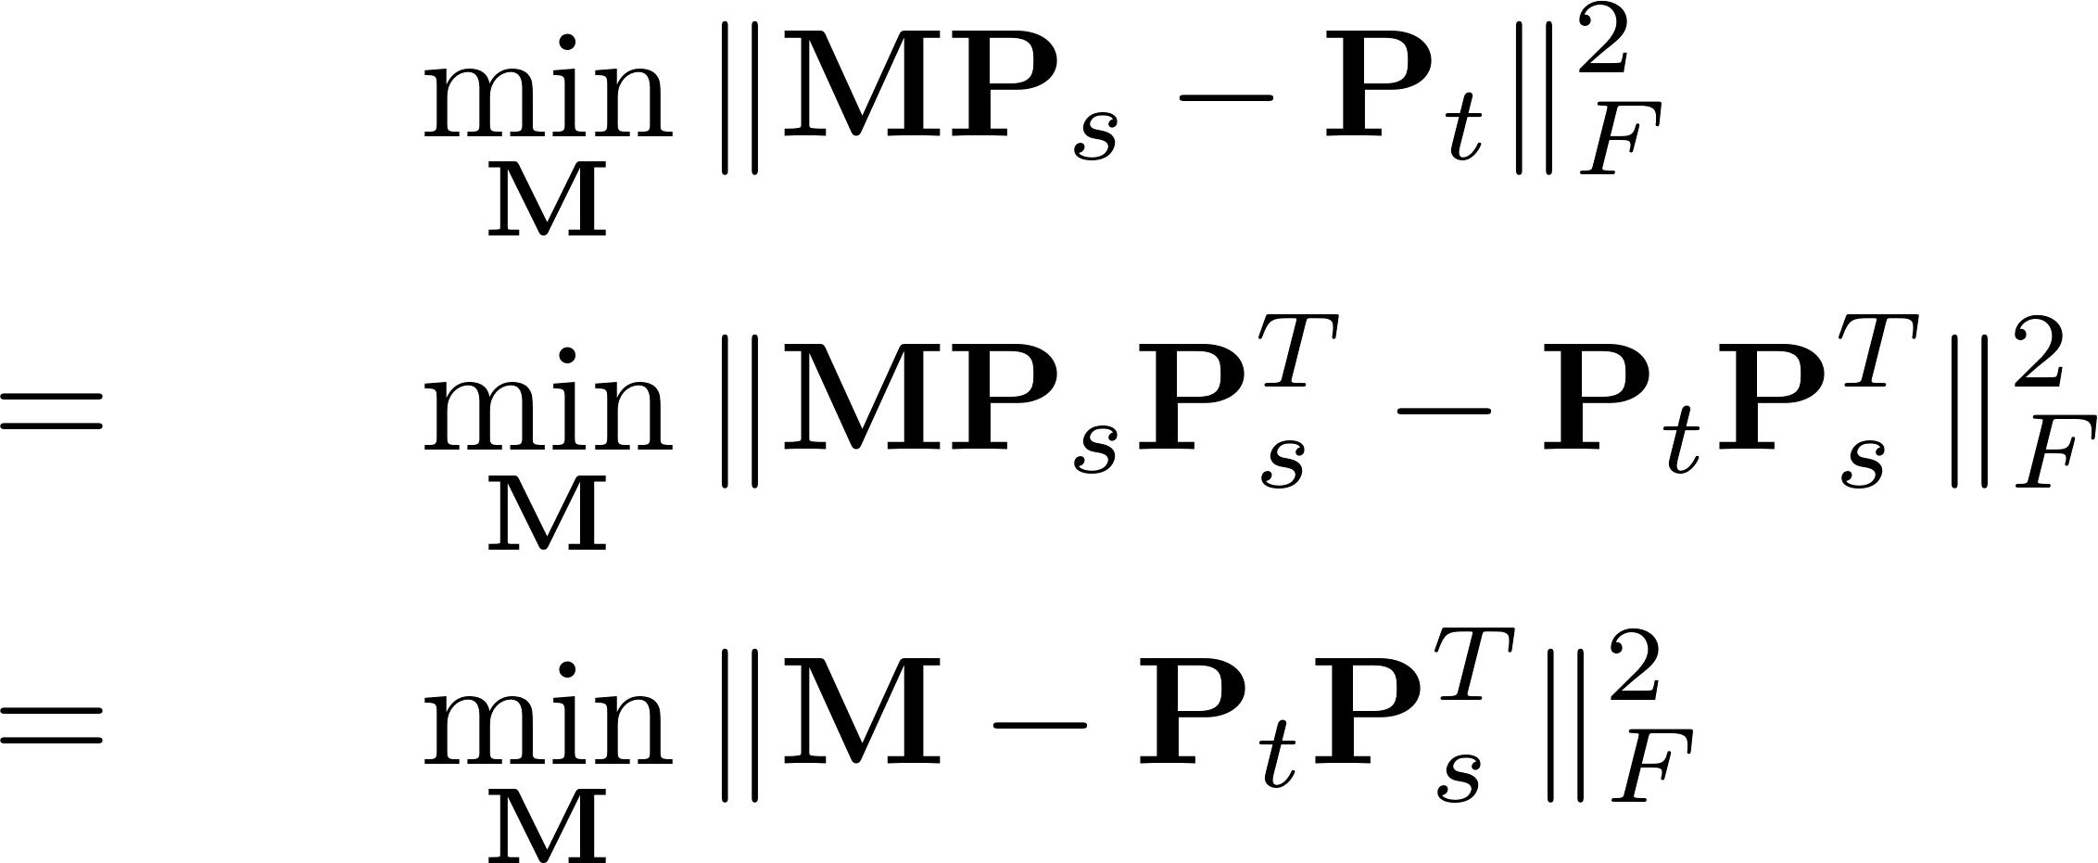
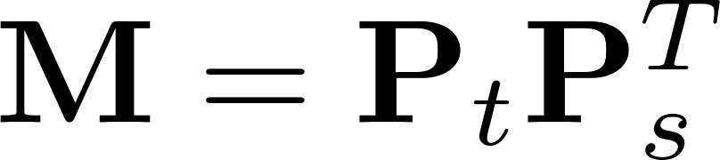
Subspace Alignment (SA)
PCA
PCA

Slide 15
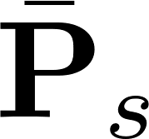
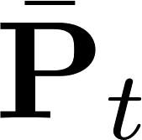
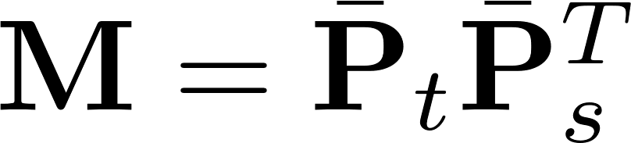
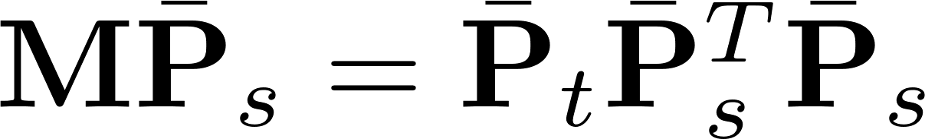
Subspace Alignment (SA)
Keep leading vectors in and , get and
Aligned source subspace:

Slide 16
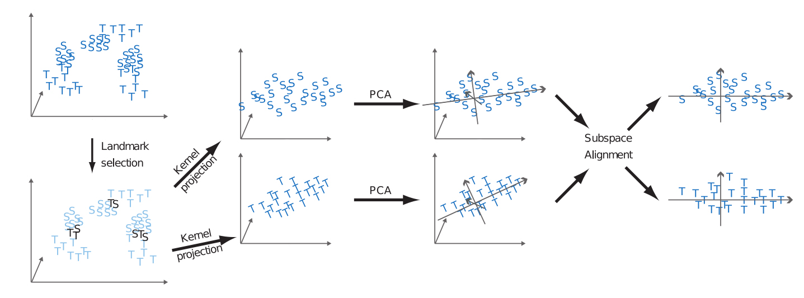
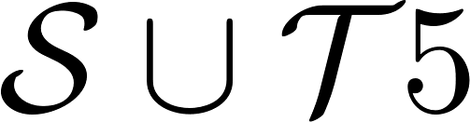

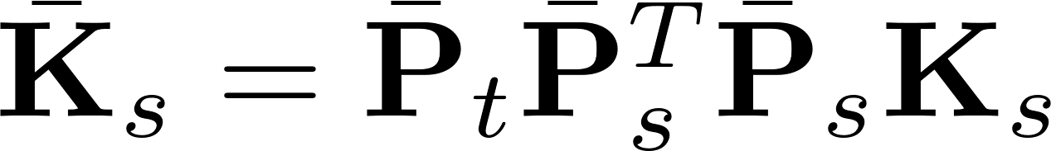
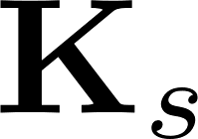
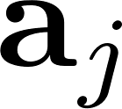
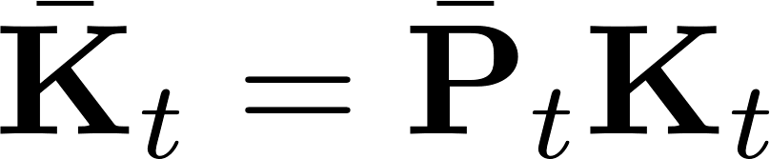
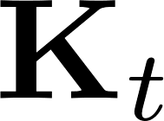

Landmarks Selection-based Subspace Alignment (LSSA)
Aljundi, Rahaf, et al. "Landmarks-based kernelized subspace alignment for unsupervised domain adaptation." CVPR, 2015.
landmarks selection and kernel projection

Slide 17
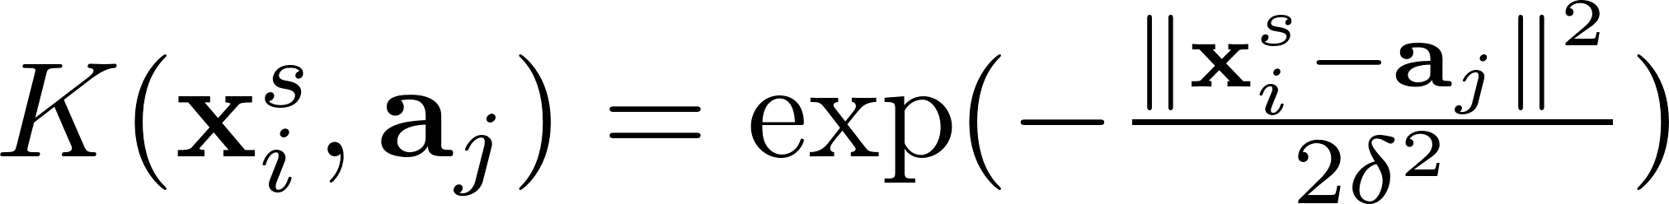
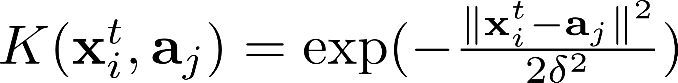
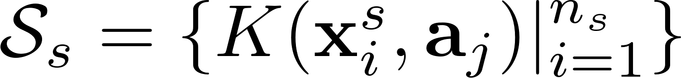
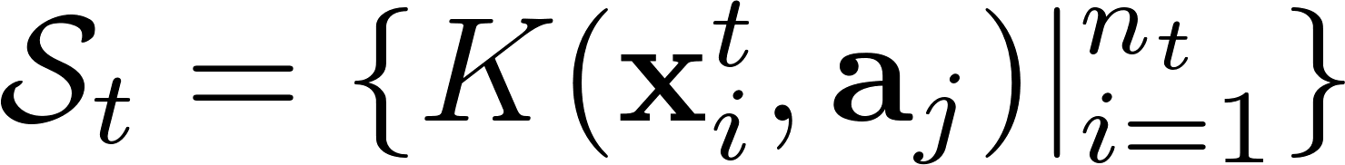
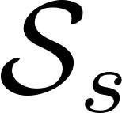

Landmarks Selection-based Subspace Alignment (LSSA)
Landmarks selection
For each , we have and
Select those
for which the distributions and have the largest overlap.
Kernel projection

Slide 18


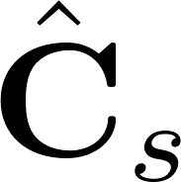
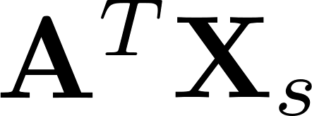
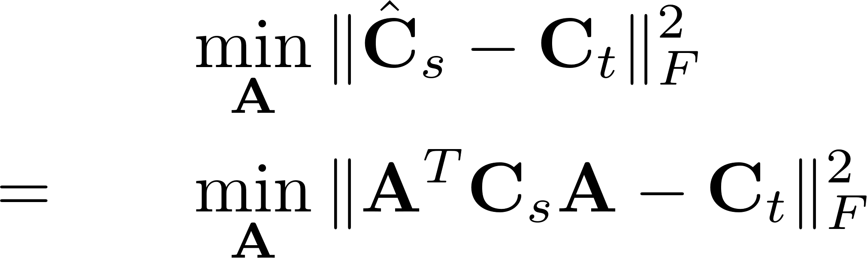
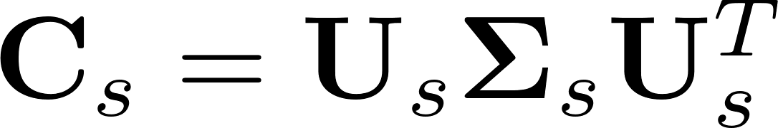
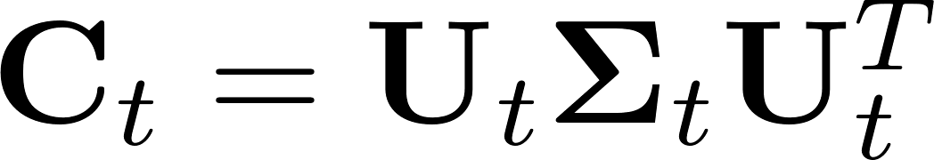

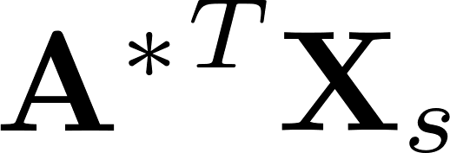
CORrelation ALignment (CORAL)
Sun, Baochen, Jiashi Feng, and Kate Saenko. "Return of frustratingly easy domain adaptation." AAAI, 2016.
and : covariance matrices of and
: covariance matrix of
align two covariance matrices
The optimal solution
After obtaining , use and

Slide 19
Relation Between DIP and CORAL
DIP: align first-order information (mean vector)
CORAL: align second-order information (covariance matrix)

Slide 20




Summary
When , symmetric projection
When , asymmetric projection

Slide 21
Domain Adaptation
Traditional era
Projection to common subspace
Interpolation on the manifold
Sample selection
Domain-invariant dictionary
Low-rank reconstruction

Slide 22





Sampling Geodesic Flow (SGF)
Gopalan, Raghuraman, Ruonan Li, and Rama Chellappa. "Domain adaptation for object recognition: An unsupervised approach." ICCV, 2011.

Slide 23



Geodesic Flow Kernel (GFK)
Gong, Boqing, et al. "Geodesic flow kernel for unsupervised domain adaptation." CVPR, 2012.

Slide 24
Domain Adaptation
Traditional era
Projection to common subspace
Interpolation on the manifold
Sample selection
Domain-invariant dictionary
Low-rank reconstruction

Slide 25



Kernel Mean Matching (KMM)
Huang, Jiayuan, et al. "Correcting sample selection bias by unlabeled data." NIPS. 2007.
Step 1:
Step 2:

Slide 26


Kernel Mean Matching (KMM)
positive samples
negative samples
source
target
Assign different weights on source domain samples.

Slide 27


Kernel Mean Matching (KMM)
positive samples
negative samples
source
target
Assign different weights on source domain samples.

Slide 28

Kernel Mean Matching (KMM)
Maximum Mean Discrepancy (MMD)
positive samples
negative samples
source
target
source
target
Assigning different weights on source domain samples is equivalent to minimizing the distance between two centers.

Slide 29



Selective Transfer Machine (STM)
Chu, Wen-Sheng, Fernando De la Torre, and Jeffery F. Cohn. "Selective transfer machine for personalized facial action unit detection." CVPR, 2013.
Alternating solution:
Fix , update
Fix , update

Slide 30

Domain Adaptation SVM (DASVM)
Bruzzone, Lorenzo, and Mattia Marconcini. "Domain adaptation problems: A DASVM classification technique and a circular validation strategy." T-PAMI, 32.5 (2010): 770-787.
positive
negative
unlabeled
source domain samples
target domain samples

Slide 31
Domain Adaptation
Traditional era
Projection to common subspace
Interpolation on the manifold
Sample selection
Domain-invariant dictionary
Low-rank reconstruction

Slide 32


Shared Domain-adapted Dictionary Learning (SDDL)
Shekhar, Sumit, et al. "Generalized domain-adaptive dictionaries.“ CVPR, 2013.

Slide 33
Domain Adaptation
Traditional era
Projection to common subspace
Interpolation on the manifold
Sample selection
Domain-invariant dictionary
Low-rank reconstruction

Slide 34




Robust Domain Adaptation with Low-rank Reconstruction (RDALR)
Jhuo, I-Hong, et al. "Robust visual domain adaptation with low-rank reconstruction." CVPR, 2012.
Low rank representation
(LRR)

Slide 35

Robust Domain Adaptation with Low-rank Reconstruction (RDALR)
Low rank representation
(LRR)
RDALR

Slide 36

Low-rank Transfer Subspace Learning (LTSL)
Shao, Ming, Dmitry Kit, and Yun Fu. "Generalized transfer subspace learning through low-rank constraint." IJCV 109.1-2 (2014): 74-93.
RDALR
LTSL

Slide 37

Summary
sample selection
feature projection/encoding

Slide 38


So many methods, how to choose?
Ying Wei, Yu Zhang, and Qiang Yang. “learning to transfer." ICML, 2018

Slide 39
Domain Adaptation
Traditional era
Early deep era
GAN era

Slide 40

Traditional Machine Learning V.S. Deep Learning

Slide 41



Convolutional Neural Network
Convolutional layer:
Fully connected layer:

Slide 42
Domain Adaptation
Early deep era
Deep feature + traditional method
Deep network + traditional idea
Batch normalization based
Adversarial learning

Slide 43
Deep learning feature + Traditional method
deep learning feature + SGF
Chopra, Sumit, Suhrid Balakrishnan, and Raghuraman Gopalan. "Dlid: Deep learning for domain adaptation by interpolating between domains." ICML workshop, 2013.
deep learning feature + GFK/SA
Hoffman, Judy, et al. "One-shot adaptation of supervised deep convolutional models." arXiv preprint arXiv:1312.6204 (2013).

Slide 44
Domain Adaptation
Early deep era
Deep feature + traditional method
Deep network + traditional idea
Batch normalization based
Adversarial learning

Slide 45

Zeng, Xingyu, et al. "Deep learning of scene-specific classifier for pedestrian detection." European Conference on Computer Vision. Springer, Cham, 2014.

Slide 46

Long, Mingsheng, et al. "Learning transferable features with deep adaptation networks." arXiv preprint arXiv:1502.02791(2015).

Slide 47

Deep CORAL
Sun, Baochen, and Kate Saenko. "Deep coral: Correlation alignment for deep domain adaptation." ECCV, 2016.

Slide 48

Domain Separation Networks
Bousmalis, Konstantinos, et al. "Domain separation networks." NIPS, 2016.

Slide 49
Domain Adaptation
Early deep era
Deep feature + traditional method
Deep network + traditional idea
Batch normalization based
Adversarial learning

Slide 50












Z-score normalization
2-dim feature
-4 -2 0 2 4
-2 -1 0 1 2

Slide 51




Domain Adaptive Batch Normalization
Li, Yanghao, et al. "Revisiting batch normalization for practical domain adaptation." ICLR workshop, 2017
BN
BN
BN
BN
BN
BN

Slide 52






Domain Adaptive Batch Normalization
Cariucci, Fabio Maria, et al. "Autodial: Automatic domain alignment layers." ICCV, 2017.
DA layer
softmax loss
entropy loss

Slide 53
Domain Adaptation
Early deep era
Deep feature + traditional method
Deep network + traditional idea
Batch normalization based
Adversarial learning

Slide 54
Not only classify categories, but also classify domains.
category classifier
domain classifier

Slide 55

Tzeng, Eric, et al. "Simultaneous deep transfer across domains and tasks." ICCV, 2015.

Slide 56

Ganin, Yaroslav, and Victor Lempitsky. "Unsupervised domain adaptation by backpropagation." arXiv preprint arXiv:1409.7495 (2014).

Slide 57
Domain Adaptation
Traditional era
Early Deep era
GAN era

Slide 58
Previous adversarial learning: feature-level
Generative Adversarial Network: image-level

Slide 59




Generative Adversarial Network (GAN)
discriminator
real (0) or fake (1)?
generator
real (0) or fake (1)?

Slide 60



Conditional GAN
discriminator
real (0) or fake (1)?
generator
real (0) or fake (1)?

Slide 61
Domain Adaptation
GAN era
Paired GAN
Unpaired GAN

Slide 62

pix2pix
Isola, Phillip, et al. "Image-to-image translation with conditional adversarial networks." CVPR. 2017

Slide 63

pix2pix
Isola, Phillip, et al. "Image-to-image translation with conditional adversarial networks." CVPR. 2017

Slide 64
pix2pix
Isola, Phillip, et al. "Image-to-image translation with conditional adversarial networks." CVPR. 2017

Slide 65

pix2pix
semantic label photo
architectural label photo
BW color photo
map aerial photo
day night
sketch photo

Slide 66
Domain Adaptation
GAN era
Paired GAN
Unpaired GAN

Slide 67


Slide 68



Cycle GAN
Zhu, Jun-Yan, et al. "Unpaired image-to-image translation using cycle-consistent adversarial networks." ICCV, 2017.
cycle

Slide 69





Cycle GAN

Slide 70



Emerging Research Directions
Open-set domain adaptation/partial transfer learning
Panareda Busto, Pau, and Juergen Gall. "Open set domain adaptation." ICCV, 2017.

Slide 71


Emerging Research Directions
Distant domain adaptation
Tan, Ben, et al. "Transitive transfer learning." SIGKDD, 2015.
Tan, Ben, et al. "Distant domain transfer learning." AAAI, 2017.

Slide 72
Thanks!

